Slide 1
Fourier analysis of spatial/spatio-temporal data
Yasumasa Matsuda
Tohoku University

Slide 2
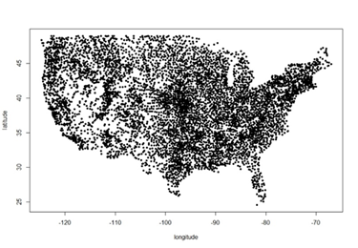
From time series to spatial data, surface time series
Sunspot, $X_{t}, t=1,2,…$
Rainfall, $X\left(s\right), s∈D⊂R^{2}$
No definite order
Irregularly spaced
Irregular domain
Surface time series, $X_{t}\left(s\right), t=1,2,…,s∈D⊂R^{2}$

Slide 3
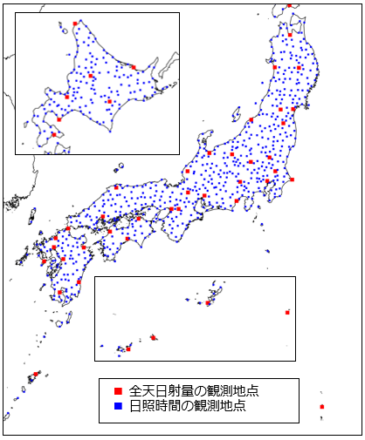
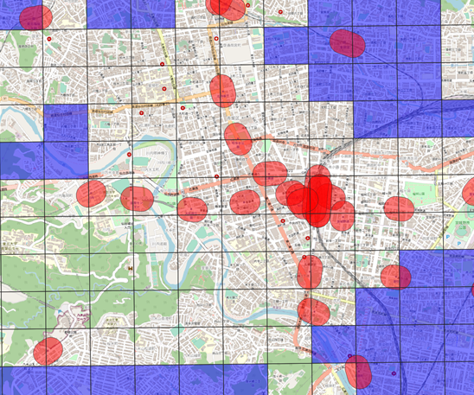
Motivations: analysis of three surface time series
1. covid: city level weekly new cases per 10,000 residents
2. mobility: weekly aggregated population on $500$m meshes
3. rainfall: weekly aggregated observations at 936 stations
mobility on 500m meshes
936 rainfall stations
Covid cases in 1,800cities

Slide 4
overview
0. Preliminary: from time series to spatial data
Review: Fourier analysis of time series
Extension to spatial data with introduction of CARMA models
Extension to surface time series
VAR models for surface time series
Estimation on the frequency domain
Asymptotic properties
Applications to NTT Docomo human mobility survey

Slide 5
Fourier analysis
$$f(ω)∈L^{2}\left(−π,π\right)$$
Fourier transform:
$$γ_{k}=\int_{−∞}^{∞}{f\left(ω\right)e^{−ikω}dω}, k=0,±1,…$$
Inverse Fourier transform:
$$f\left(ω\right)=\frac{1}{2π}\sum_{k=−∞}^{∞}{γ_{k}e^{ikω}}$$
Parseval's identity
$$\int_{−π}^{π}{{\left|f\left(ω\right)\right|}^{2}dω}={\left(2π\right)}^{−2}\sum_{k=−∞}^{∞}{{\left|γ_{k}\right|}^{2}}$$
$$f(ω)∈L^{2}\left(−∞,∞\right)$$
Fourier transform:
$$γ\left(u\right)=\int_{−∞}^{∞}{f\left(ω\right)e^{−iuω}dω}, −∞<u<∞$$
Inverse Fourier transform:
$$f\left(ω\right)=\frac{1}{2π}\int_{−∞}^{∞}{γ\left(u\right)e^{iuω}du}$$
Parseval's identity
$$\int_{−∞}^{∞}{{\left|f\left(ω\right)\right|}^{2}dω}={\left(2π\right)}^{−2}\int_{−∞}^{∞}{{\left|γ\left(u\right)\right|}^{2}du}$$

Slide 6
Stationary time series
Stationary time series $\left\{X_{t}\right\}, t=1,…,T,$
$$EX_{t}=m,$$
$$Cov\left(X_{t},X_{t−k}\right)=γ_{k}$$
If $\sum_{k}{{\left|γ_{k}\right|}^{2}<∞}$, spectral density function is defined by
$$f\left(ω\right)=\frac{1}{2π}\sum_{k=−∞}^{∞}{γ_{k}\exp\left(ikω\right)},ω∈\left[−π,π\right]$$
$$γ_{k}=\int_{−π}^{π}{f\left(ω\right)\exp\left(−ikω\right)dω}$$
In the case of $\sum_{k}{\left|γ_{k}\right|}<∞,$ short memory process
In the case of $\sum_{k}{\left|γ_{k}\right|}=∞,$ long memory process

Slide 7
Short memory time series models
Let $\left\{ε_{t}\right\}$ be iid$\left(0,σ^{2}\right)$.
ARMA(p,q):
$$X_{t}−φ_{1}X_{t−1}−…−φ_{p}X_{t−p}=ε_{t}+θ_{1}ε_{t−1}+…+θ_{q}ε_{t−q},$$
$$φ\left(B\right)X_{t}={θ\left(B\right)ε}_{t}$$
MA expression:
$$X_{t}=\frac{θ(B)}{φ(B)}ε_{t}=\sum_{j=0}^{∞}{ψ_{j}ε_{t−j}},$$
ARMA covariance is given by recursion.
ARMA spectral density function:
$$f\left(ω\right)=\frac{σ^{2}}{2π}\frac{{\left|θ\left(e^{−iω}\right)\right|}^{2}}{{\left|φ\left(e^{−iω}\right)\right|}^{2}}, ω∈[−π,π]$$

Slide 8
Spatial process
$$X\left(s\right), s∈D⊆R^{2},$$
$$EX\left(s\right)=m$$
$$Cov\left(X\left(s\right), X\left(s−h\right)\right)=γ\left(h\right), h∈R^{2},$$
If $\int{{\left|γ(h)\right|}^{2}du<∞}$, spectral density function is defined by
$$f\left(ω\right)={\left(2π\right)}^{−1}\int_{R^{2}}{γ\left(u\right)\exp\left(iu′ω\right)du},ω∈R^{2},$$
$$γ\left(u\right)=\int_{R^{2}}{f\left(ω\right)\exp\left(−iω^{′}u\right)dω}$$
Usually we consider short memory cases of bounded and L1.

Slide 9
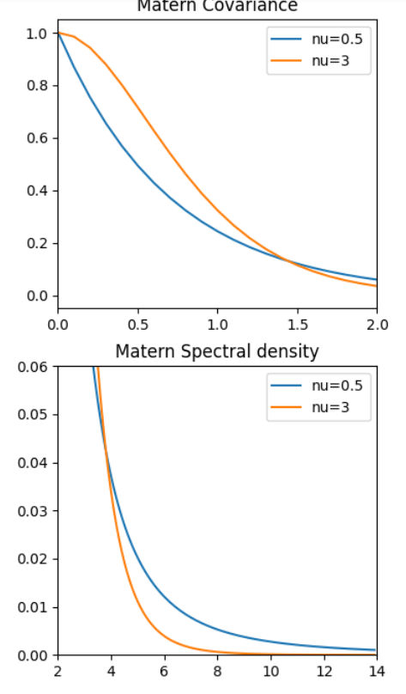
Matern class (isotropic covariance)
For $h=\left(h_{1},h_{2}\right),$ the covariance is
$$γ\left(h\right)=\frac{σ^{2}}{2^{ν−1}Γ\left(ν\right)}{\left(\frac{2\sqrt{ν}\left\|h\right\|}{ρ}\right)}^{ν}K_{ν}\left(\frac{2\sqrt{ν}\left\|h\right\|}{ρ}\right)$$
For $ω=\left(ω_{1},ω_{2}\right),$ the spectral density is
$$f\left(ω\right):={\left(2π\right)}^{−1}\int{\exp\left(ih′ω\right)γ\left(h\right)dh}=\frac{φ}{{\left(α^{2}+{\left\|ω\right\|}^{2}\right)}^{ν+1}},$$
where $α=\frac{2\sqrt{ν}}{ρ}, φ=\frac{να^{2ν}σ^{2}}{π}.$
$ν:$smoothness
$$|\left|h\right||$$
Modified Bessel func.
$$|\left|ω\right||$$
Spatial CAR(1) has Matern class covariances with $ν=2.$

Slide 10
Fourier analysis of stationary time series
Discrete time series $X_{t}, t=1,⋯,T$
Time domain
Frequency domain
$$f\left(ω\right)={\left(2π\right)}^{−1}\sum_{k=−∞}^{∞}{γ_{k}e^{ikω}},−π<ω≤π$$
$$γ_{k}=Cov\left(X_{t},X_{t−k}\right),k=0,1,⋯$$
Discrete Fourier Transform
$$\tilde{X}\left(ω_{k}\right)=\frac{1}{\sqrt{2πT}}\sum_{t=1}^{T}{X_{t}e^{−iω_{k}t}},ω_{k}=\frac{2πk}{T}$$
Parametric models for $γ_{k}$ such as by ARMA models
Gaussian likelihood
$$\tilde{X}\left(ω_{k}\right)\sim asympt. ind. \left(0, f\left(ω_{k}\right)\right)$$
Whittle likelihood (1961)
$$\log{L\left(θ\right)}=\log\left\|Σ\left(θ\right)\right\|+X′{Σ\left(θ\right)}^{−1}X$$
$$\log{L\left(θ\right)}=\sum_{k}{\log{f\left(ω_{k};θ\right)+\frac{{\left|\tilde{X}\left(ω_{k}\right)\right|}^{2}}{f\left(ω_{k};θ\right)}}}$$
$\hat{θ}$ converges in dist. to $N\left(θ,{Γ\left(θ\right)}^{−1} \right)$ by Hannan(1973)
$$Γ\left(θ\right)=\frac{1}{2π}\int_{−π}^{π}{\left[\frac{∂\log{f\left(ω;θ\right)}}{∂θ}\right]{\left[\frac{∂\log{f\left(ω;θ\right)}}{∂θ}\right]}^{′}dω}$$
for short memory time series.

Slide 11
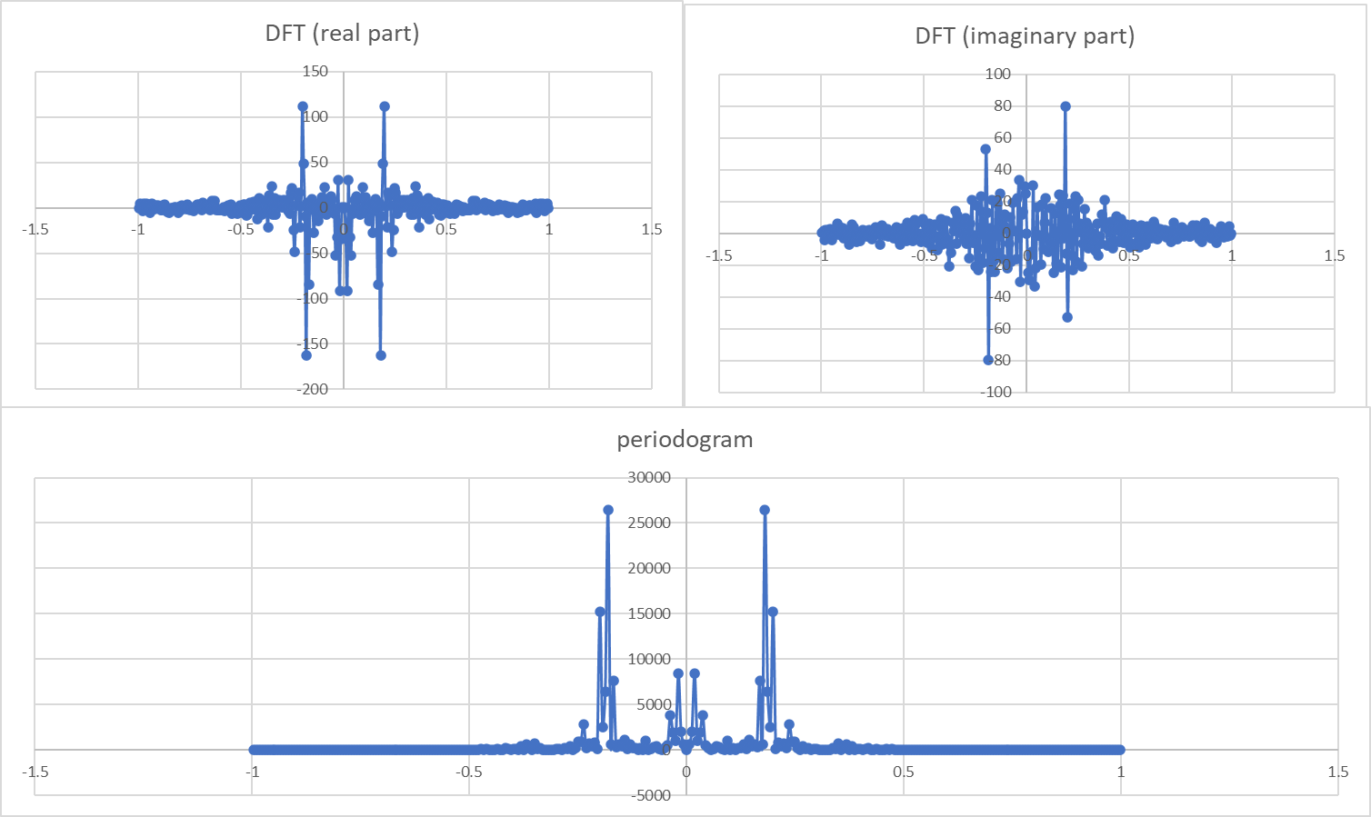
Example: sunspot numbers
$$\frac{1}{\sqrt{2πT}}\sum_{t=1}^{T}{X_{t}e^{iωt}}=\frac{1}{\sqrt{2πT}}\sum{X_{t}\cos\left(ωt\right)}+\frac{i}{\sqrt{2πT}}\sum{X_{t}\sin\left(ωt\right)}$$
$$X_{t}$$
$$ω$$
$$ω$$
$$−π$$
$$π$$
$$π$$
$$−π$$
$$I\left(ω\right)=\frac{1}{2πT}{\left|\sum{X_{t}e^{iωt}}\right|}^{2}$$
AR(2) fitting by Yule (1927)
$$ω$$
$$−π$$
$$π$$

Slide 12
Extension from time series to spatial data
Stationary time series:
$$x_{t}, t=1,…,T,$$
$$γ\left(k, θ\right)=cov\left(x_{t},x_{t−k}\right)$$
ARMA models (Box and Jenkins, 1970)
uni-variate short memory cases
Hannan (1973)
muti-variate short memory cases
Dunsmuir (1979)
Long memory cases
Yajima(1985), Fox and Taqqu(1986)
Local stationary cases
Dahlhaus(1995)
Stationary spatial data:
$$x\left(s_{j}\right), irregulary spaced$$
$$γ\left(u,θ\right)=cov\left(x(s),x(s−u) \right)$$
Spatial CARMA models (Brockwell and Matsuda, 2014)
uni-variate-short memory cases
Matsuda and Yajima (2009)
Local stationary cases
Matsuda and Yajima (2018)
multi-variate short memory cases
Matsuda and Yuan (2020)

Slide 13
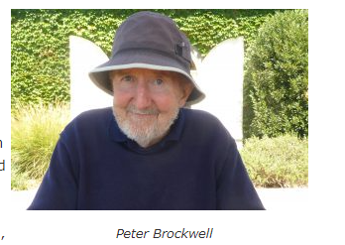
Spatial CARMA models
Stationary discrete time series
Discrete ARMA models (Box and Jenkins, 1970)
Stationary continuous spatial data
Spatial CARMA models (Brockwell and Matsuda, 2017)
Spatial extension of CARMA models (Brockwell and Lindner, 2014)
iid
$$φ\left(B\right)x_{t}=θ\left(B\right)ε_{t}$$
MA expression
$$x_{t}=\frac{θ\left(B\right)}{φ\left(B\right)}ε_{t}=\sum_{j=0}^{∞}{α_{j}ε_{t−j}}$$
Spectral density: $f\left(ω\right)=\frac{σ^{2}}{2π}\frac{{\left|θ\left(e^{−iω}\right)\right|}^{2}}{{\left|φ\left(e^{−iω}\right)\right|}^{2}}$
MA expression
$$x\left(s\right)=\int_{R^{2}}{g\left(s−u; θ\right)dL(u)}$$
CARMA(p,q) kernel
Levy process

Slide 14
Extension of time series ARMA to CARMA
Def. CARMA(2,1) model
by Brockwell and Lindner(2009):
$$\left(D^{2}+φ_{1}D+φ_{2}\right)X_{t}=\left(D+θ_{1}\right){DL}_{t}$$
$$D\left(\begin{matrix}Y_{t} \\ {DY}_{t}\end{matrix}\right)=\left(\begin{matrix}0 & 1 \\ −φ_{2} & −φ_{1}\end{matrix}\right)\left(\begin{matrix}Y_{t} \\ DY_{t}\end{matrix}\right)+\left(\begin{matrix}0 \\ 1\end{matrix}\right)dL_{t},$$ $X_{t}=(\begin{matrix}θ_{1} & 1\end{matrix})\left(\begin{matrix}Y_{t} \\ {DY}_{t}\end{matrix}\right)$,
$$X_{t}=\int_{0}^{∞}{g\left(t−u\right)dL\left(u\right), }$$
where , $Re\left(λ_{i}\right)<0$,
$$g\left(t\right)=\int_{C}{\frac{θ(z)}{φ\left(z\right)}e^{zt}dz}=\sum_{i=1}^{p}{\frac{θ(λ_{i})}{φ′(λ_{i})}e^{λ_{i}t}}.$$

Slide 15
CARMA(p,q) kernels
$$x\left(s\right)=\int_{R^{2}}{g\left(s−u; θ\right)dL(u)}$$
Define
$$φ\left(z\right)=\prod_{i=1}^{p}{\left(z^{2}−λ_{i}^{2}\right)}, θ\left(z\right)=\prod_{i=1}^{q}{\left(z^{2}−ξ_{i}^{2}\right)}$$
Then CARMA kernel is
$$g\left(s\right)=\sum_{i=1}^{p}{\frac{θ\left(λ_{i}\right)}{φ^{′}\left(λ_{i}\right)}}e^{λ_{i}\left\|s\right\|},s∈R^{2}$$
CARMA spectral density:
$$f\left(ω\right)={\left|\tilde{g}\left(ω\right)\right|}^{2}, ω∈R^{2}$$
where
$$\tilde{g}\left(ω\right)=\int_{R^{2}}{g\left(s\right)\exp\left(is′ω\right)ds}=\sum_{i=1}^{p}{\frac{2θ\left(λ_{i}\right)}{φ^{′}\left(λ_{i}\right)}}\frac{1}{{\left({\left\|ω\right\|}^{2}+λ_{i}^{2}\right)}^{3/2}}$$
CAR(1) kernel: $g\left(s\right)=e^{−δ\left\|s\right\|}$
CARMA(2,1) kernel: $g\left(s\right)={αe}^{−δ_{1}\left\|s\right\|}+\left(1−α\right)e^{−δ_{2}\left\|s\right\|}$
CAR(1) = Matern class with $ν=2$

Slide 16
Levy sheet on
$L(A),A∈B\left(R^{d}\right), \text{is} \text{said} \text{to} \text{be} \text{a} \text{Levy} \text{sheet}$ for
$L\left(A\right) \text{is} \text{a} \text{random} \text{variable} \text{that} \text{depends} \text{on} \left|A\right|.$
$A∩B=φ\text{, }A,B∈B\left(R^{d}\right)⇒L\left(A\right),L\left(B\right) \text{are} \text{independent}\text{.}$
Brownian sheet
Compound Poisson sheet
$$x\left(s\right)=\sum_{j}{g(s−u_{j})ε_{j}}$$

Slide 17
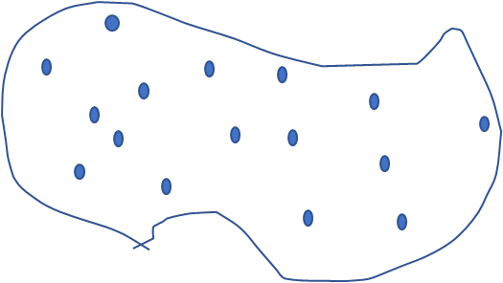
Fourier analysis of spatial data
$$X\left(s\right),s∈D⊂R^{2}$$
Frequency domain
Spatial domain
$$f\left(ω\right)={\left(2π\right)}^{−2}\int_{R^{2}}{γ\left(u\right)}e^{iu^{′}ω}du, ω∈R^{2}$$
$$γ\left(u\right)=Cov\left(X\left(s\right),X\left(s−u\right)\right),u∈R^{2}$$
$$\tilde{X}\left(ω\right)=\int_{D}{X\left(s\right)}e^{−iω^{′}s}ds$$
$$A_{2}$$
$$ω_{k}=\left(\frac{2πi_{1}}{A_{1}},\frac{2πi_{2}}{A_{2}}\right)$$
irregularly spaced data
$$\tilde{X}\left(ω_{k}\right)=\frac{1}{N}\sum_{j=1}^{N}{X\left(s_{j}\right)e^{−iω_{k}^{′}s_{j}}}$$
$$X\left(s_{j}\right),s_{j}∈D$$
$$A_{1}$$
$$D$$
$$\log{L\left(θ\right)}=\sum_{ω_{k}∈F_{D}}{\log{f\left(ω_{k};θ\right)+\frac{{\left|{\tilde{X}}_{N}\left(ω_{k}\right)\right|}^{2}}{f\left(ω_{k};θ\right)}}}$$
$$\log{L\left(θ\right)}=\log\left\|Σ\left(θ\right)\right\|+X′{Σ\left(θ\right)}^{−1}X$$
by Matsuda and Yajima (2009)

Slide 18
Remark: bias issues of periodogram
$$\log{L\left(θ\right)}=\sum_{ω_{k}∈F_{D}}{log\left\{f\left(ω_{k};θ\right)+bias\right\}{+\frac{{\left|{\tilde{X}}_{N}\left(ω_{k}\right)\right|}^{2}}{f\left(ω_{k};θ\right)+bias}}}$$
$${E\left|{\tilde{X}}_{N}\left(ω_{k}\right)\right|}^{2}=E{\left\{\frac{1}{N}\sum_{p=1}^{N}{X\left(s_{p}\right)e^{−iω_{k}^{′}s_{p}}}\right\}}^{2}$$
$$=\frac{1}{N^{2}}\sum_{p≠q}{EX\left(s_{p}\right)X\left(s_{q}\right)e^{i\left(s_{p}−s_{q}\right)′ω_{k}}}+\frac{1}{N^{2}}\sum_{j}{{EX}^{2}\left(s_{j}\right)}$$
bias
$$f\left(ω_{k}\right)$$

Slide 19
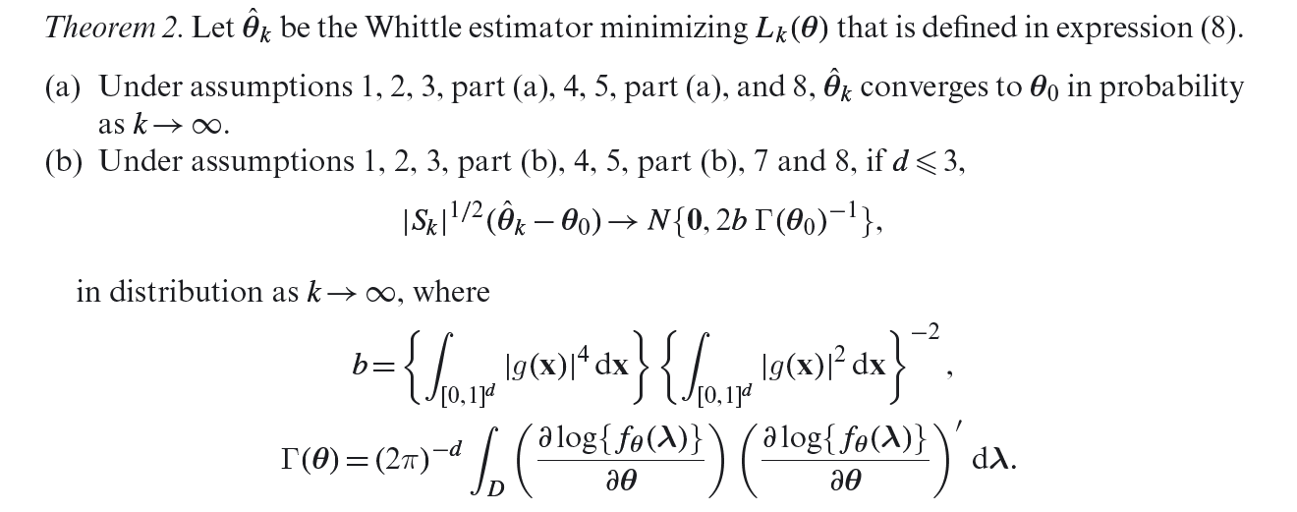
Asymptotic justifications
Mixed asymptotics
$$A_{1},A_{2}→∞,\frac{A_{1}A_{2}}{N}→0$$
$$\left\{s_{j}, j=1,…,N\right\}\sim iid with {\left|A_{1}A_{2}\right|}^{−1}g\left(\frac{x_{1}}{A_{1}},\frac{x_{2}}{A_{2}}\right)$$
Describe irregularity by pdf$g\left(u\right)$ on unit square
Matsuda and Yajima (2009)
Essential conditions
Finite moments of all orders
Smooth cumulant spectrum

Slide 20
$$EX=E\left\{E\left(X|Y\right)\right\}$$
$$\frac{1}{N^{2}}\sum_{p≠q}{EX\left(s_{p}\right)X\left(s_{q}\right)e^{i\left(s_{p}−s_{q}\right)′ω_{k}}}=\frac{1}{N^{2}}\sum_{p≠q}{E\left[E\left\{\left.X\left(s_{p}\right)X\left(s_{q}\right)e^{i\left(s_{p}−s_{q}\right)′ω_{k}}\right|s_{p},s_{q}\right\}\right]}=\frac{1}{N^{2}}\sum_{p≠q}{E\left\{γ\left(s_{p}−s_{q}\right)e^{i\left(s_{p}−s_{q}\right)′ω_{k}} \right\}}=\frac{N^{2}−N}{N^{2}}\int{γ\left(u−v\right)e^{i\left(u−v\right)′ω_{k}}g\left(\frac{u}{A}\right)g\left(\frac{v}{A}\right)dudv}$$

Slide 21
Summary for Part 1
Extension of Whittle likelihood for stationary spatial data
Efficient computations
Asymptotic analysis under the mixed asymptotics
Criticism:
Huge sample sizes are necessary.
High frequency components are ignored.
Poor estimation for the smoothness parameter of Matern Class.
Spatial or frequency domain approach should be selected according to data features.

Slide 22
Motivations: analysis of three surface time series
1. covid: city level weekly new cases per 10,000 residents
2. mobility: weekly aggregated population on $500$m meshes
3. rainfall: weekly aggregated observations at 936 stations
mobility on 500m meshes
936 rainfall stations
Covid cases in 1,800cities

Slide 23
overview
0. Preliminary: from time series to spatial data
Review: Fourier analysis of time series
Extension to spatial data
Extension to surface time series
Introduction of VAR models
VAR models for surface time series
Estimation on the frequency domain
Asymptotic properties
Applications to NTT Docomo human mobility survey

Slide 24
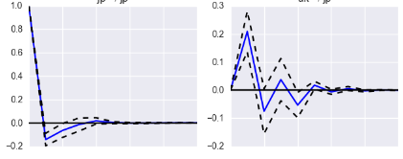
Bi-variate VAR models
Univariate AR(1) model
$$X_{t}=φX_{t−1}+ε_{t},$$
Bivariate VAR(1) model
$$\left(\begin{matrix}X_{1t} \\ X_{2t}\end{matrix}\right)=\left(\begin{matrix}A_{11} & A_{12} \\ A_{21} & A_{22}\end{matrix}\right)\left(\begin{matrix}X_{1,t−1} \\ X_{2,t−1}\end{matrix}\right)+\left(\begin{matrix}ε_{1t} \\ ε_{2t}\end{matrix}\right)$$
Impulse response function (IRF): initializing by
$$\left(\begin{matrix}ε_{1,0} \\ ε_{2,0}\end{matrix}\right)=\left(\begin{matrix}1 \\ 0\end{matrix}\right), \left(\begin{matrix}X_{1,0} \\ X_{2,0}\end{matrix}\right)=\left(\begin{matrix}0 \\ 0\end{matrix}\right),$$
$\left(\begin{matrix}X_{1t} \\ X_{2t}\end{matrix}\right)$ evaluated by the recursion is defined as IRF.

Slide 25
Applications to surface time series analysis
$$x_{t}\left(s\right), s∈D⊂R^{2}, t=1,…,T$$
Ex. # of Covid cases, human mobility and rain fall, collected weekly
1st week in Jan. 2020
2nd week
3rd week
4th week
Lots of NAs, data points are not necessarily the same

Slide 26
(V)AR models for surface time series
Let
$$x_{t}\left(s\right), s∈S⊂R^{2}, t=1,2,…$$
$$x_{t}\left(s\right)=β_{1}{ x}_{t−1}\left(s\right)+β_{2}\int{φ\left(s−u;θ\right)x_{t−1}\left(u\right)du}+ε_{t}\left(s\right),$$
with CARMA kernels:
$$φ\left(s; θ\right)=\frac{1}{2πθ^{2}}e^{−\left\|s\right\|/θ},$$
spatial effect
spatial CARMA errors
Non-spatial effect
Notice that
$$\int{e^{−\left\|s\right\|/θ}}ds=2πθ^{2}$$

Slide 27
Temporal stationary conditions
$$x_{t}\left(s\right)=\sum_{i=1}^{p}{φ_{i}(x_{t−1}\left(s\right))}+ε_{t}\left(s\right),$$
is temporally stationary, if
$$1−\sum_{i=1}^{p}{\left\|φ_{i}\right\|}z^{i}=0$$
has zeros outside the unit circle. In our case,
$$\left\|φ_{i}\right\|≤\left|β_{1i}\right|+\left|β_{2i}\right|,$$
$$x_{t}\left(s\right)={\sum_{i=1}^{p}{{β_{1i}x_{t−i}\left(s\right)+β}_{2i}\int{φ\left(s−u;θ\right)x_{t−1}\left(u\right)du}}}_{}+ε_{t}\left(s\right),$$

Slide 28
Stationary in space
For $t=1,2,…,T,$
$$x_{t}\left(s\right)=\sum_{i=1}^{p}{φ_{i}(x_{t−1}\left(s\right))}+ε_{t}\left(s\right).$$
If $x_{0}\left(s\right)$ and $ε_{t}\left(s\right), t=1,…,T,$ are stationary in space,
$x_{t}\left(s\right), t=1,…,T,$ are stationary in space, for any bounded operator $φ_{i}.$

Slide 29
Fourier transform of convolution
$$x_{t}\left(s\right)=β_{1}x_{t−1}\left(s\right)+β_{2}\int{φ(s−u;θ)x_{t−1}\left(u\right)du}+ε_{t}\left(s\right)$$
Applying Fourier transform in space,
$${\tilde{x}}_{t}\left(ω\right)=\int{e^{−is^{′}ω}x_{t}\left(s\right)ds}$$
we have
$${\tilde{x}}_{t}\left(ω\right)=β_{1}{\tilde{x}}_{t−1}\left(ω\right)+β_{2}\tilde{φ}\left(ω;θ\right){\tilde{x}}_{t−1}\left(ω\right)+\tilde{ε}\left(ω\right)$$
where
$$\tilde{φ}\left(ω;θ\right)=\frac{1}{{θ^{3}\left({\left\|ω\right\|}^{2}+θ^{−3/2}\right)}^{2}}$$
for $φ\left(s;θ\right)=\frac{1}{2πθ^{2}}e^{−\frac{\left\|s\right\|}{θ}}$

Slide 30
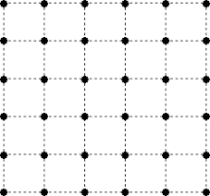
Least Square Estimation on the frequency domain
$$ω_{p}=\left(\frac{2πp_{1}}{A_{1}},\frac{2πp_{2}}{A_{2}}\right),p=1.⋯,N/2$$
For $ω_{p}=\left(ω_{p1},ω_{p2}\right),p=1,⋯,N/2,$ let
$${\hat{x}}_{t}\left(ω_{p}\right)=\frac{1}{n_{1t}}\sum_{j=1}^{n_{1t}}{x_{t}\left(s_{tj}\right)}e^{−iω_{p}^{′}s_{tj}}.$$
$\hat{θ}=argmin Q\left(β_{1},β_{2},θ\right)$,
where
$$Q\left(β,θ\right)=\sum_{t=1}^{T}{\sum_{p=1}^{N/2}{{\left\{{\hat{x}}_{t}\left(ω_{p}\right)−β_{1}{\hat{x}}_{t−1}\left(ω_{p}\right)−β_{2}\tilde{φ}\left(ω;θ\right){\hat{x}}_{t−1}\left(ω_{p}\right)\right\}}^{2}}},$$
Discrete Fourier Transform
LSE on frequency domain:
frequency domain

Slide 31
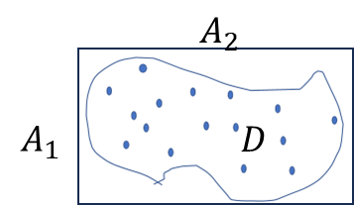
Asymptotic scheme
$$x_{t}\left(s_{t_{j}}\right),j=1,⋯,N_{t},t=1,⋯,T$$
diverge, finite
Mixed asymptotics
$$A_{1},A_{2}→∞,\frac{A_{1}A_{2}}{N_{t}}→0$$
$$\left\{s_{t_{j}}, j=1,…,N\right\}\sim iid with {\left|A_{1}A_{2}\right|}^{−1}g\left(\frac{x_{1}}{A_{1}},\frac{x_{2}}{A_{2}}\right)$$
$$s_{t_{j}}$$
Describe irregularity by pdf$g\left(u\right)$ on unit square

Slide 32
conditions
1. $x_{t}(s)$ is stationary across s and
$$f_{x,t }\left(ω\right)=\int_{R^{2}}{cov\left(x_{t}\left(s\right),x_{t}\left(s−u\right)\right)e^{iu′ω}du}$$
where $f_{x }\left(ω\right)$is positive definite and twice differentiable.
2. $ε_{t}(s)$ is stationary across s and
$$f_{ε,t_{1},t_{2}}\left(ω\right)=\int_{R^{2}}{cov\left(ε_{t_{1}}\left(s\right),ε_{t_{2}}\left(s−u\right)\right)e^{iu′ω}du}$$
where $f_{ε }\left(ω\right)$is positive definite and twice differentiable.

Slide 33
consistency

Slide 34
Asymptotic normality

Slide 35
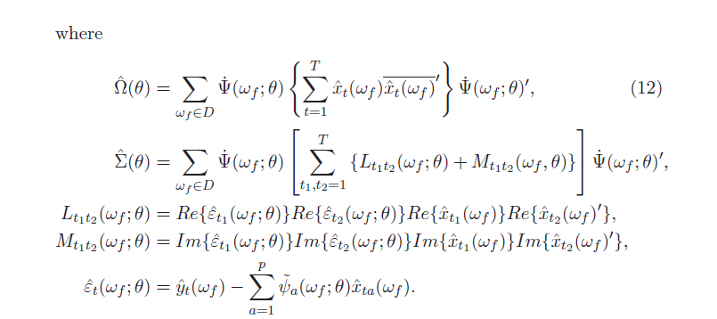
Consistent estimation for asympt. variance

Slide 36
Simulation of spatial spurious regression
Simulate 6000 points uniformly on [0,20]x[0,20]
for t=1,2,…,30
Cf: spurious regression
$$y_{t}=y_{t−1}+ε_{t}$$
$$x_{t}=x_{t−1}+f_{t}$$
Fit the regression:
$$y_{t}=βx_{t}+v_{t}$$
$x_{t},y_{t}$ are independent, but
ols diverges
$$y_{t}\left(s\right)=\sum_{k}{u_{tk}e^{−γ_{1}\left\|s−η_{k}\right\|}},$$
$$u_{tk}=u_{t−1,k}+ε_{tk}$$
$$x_{t}\left(s\right)=\sum_{k}{ξ_{tk}e^{−γ_{1}\left\|s−η_{k}\right\|}},$$
$$ξ_{tk}=ξ_{t−1,k}+f_{tk}$$
$$y_{t}\left(s\right)=βx_{t}\left(s\right)du+v_{t}\left(s\right)$$
independent
iid
iid
Fit the regression

Slide 37
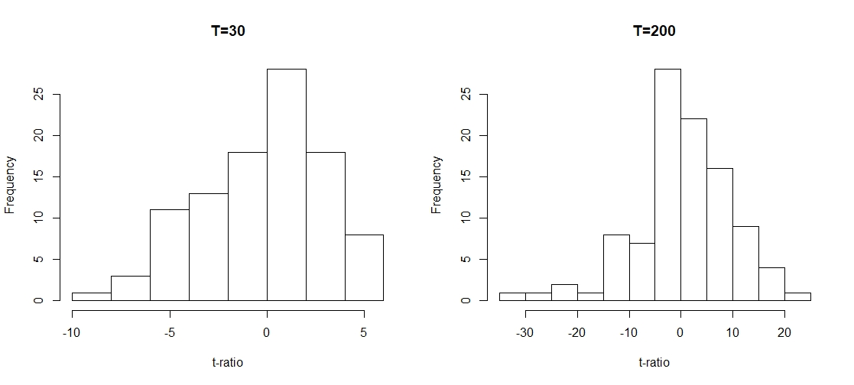
Free from spurious regression problems
T=30
T=100
Cf. spurious regression
$$y_{t}=β_{0}+β_{1}x_{t}+ε_{t}$$
x and y are I(1), ind.

Slide 38
Analysis of three surface time series
1. covid: city level weekly new cases per 10,000 residents
2. mobility: weekly aggregated population on $500$m meshes
3. rainfall: weekly aggregated observations at 936 stations
mobility on 500m meshes
936 rainfall stations
Covid cases in 1,800cities

Slide 39
Bi-variate VAR extension with exogenous variables
lagged covid
lagged mobility
covid
$$y_{t}\left(s\right)=α_{11}y_{t−1}\left(s\right)+β_{11}\int_{D}{φ\left(s−u;θ_{1}\right)y_{t−1}\left(u\right)du}+α_{12}x_{t−1}\left(s\right)+β_{12}\int_{D}{φ\left(s−u;θ_{2}\right)x_{t−1}\left(u\right)du}$$
$$+ γz_{t}\left(s\right)+δ\int_{D}{φ\left(s−u;θ_{3}\right)z_{t}\left(u\right)du}+ε_{t}\left(s\right),$$
$$x_{t}\left(s\right)=α_{21}x_{t−1}\left(s\right)+β_{21}\int_{D}{φ\left(s−u;θ_{1}\right)x_{t−1}\left(u\right)du}+α_{22}y_{t−1}\left(s\right)+β_{22}\int_{D}{φ\left(s−u;θ_{2}\right)y_{t−1}\left(u\right)du}$$
$$+ ξz_{t}\left(s\right)+η\int_{D}{φ\left(s−u;θ_{3}\right)z_{t}\left(u\right)du}+f_{t}\left(s\right)$$
rainfall
lagged mobility
lagged covid
mobility
rainfall

Slide 40
Bi-variate AR fitting for (covid and mobility)
 |  | covid |  | human mobility
 |  | est. | t val | est. | t val
covid(-1) | spatial | 1.08 | 4.64
 | non-spatial | 0.36 | 1.45 | -0.0043 | -8.51
covid(-2) | spatial | -1.00 | -4.62
 | non-spatial | 0.47 | 2.04 | 0.013 | 6.12
covid(-3) | spatial | 0.06 | 1.27
 | non-spatial | -0.11 | -3.16 | -0.0070 | -8.41
mob(-1) | spatial | -0.80 | -3.89
 | non-spatial | -0.30 | -2.21 | 0.691 | 230
mob(-2) | spatial | 0.80 | 3.68
 | non-spatial | 0.059 | 0.41 | 0.219 | 94
mob(-3) | spatial | 0.048 | 0.41
 | non-spatial | 0.34 | 8.32 | 0.071 | 18
rain(0) | spatial
 | non-spatial | 0.00099 | 0.86 | -0.00081 | -6.8
rain(-1) | spatial
 | non-spatial | 0.00076 | 0.62 | 0.00075 | 6.6
rain(-2) | spatial
 | non-spatial | -0.00039 | -0.27 | -0.00038 | -3.2

Slide 41
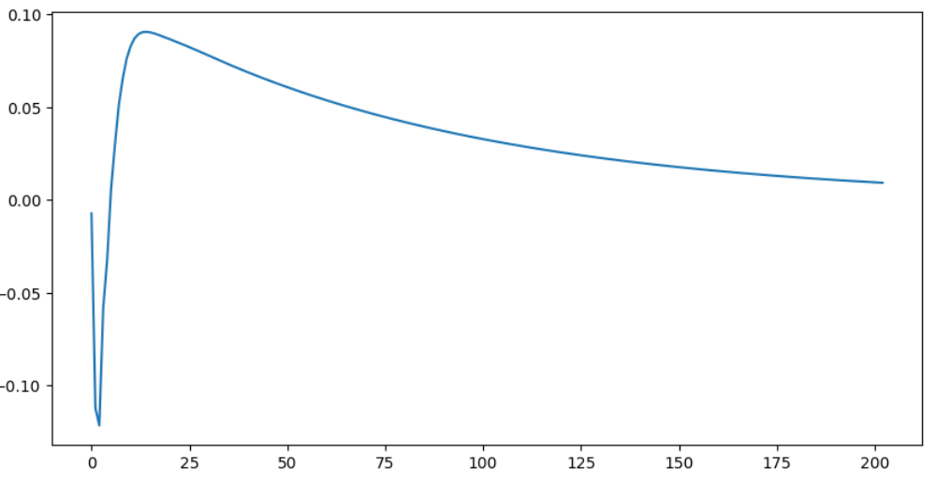
Impulse Response Function: =response of covid by one unit increase of mobility
500 km square

Slide 42
Summary: surface time series
discrete time series of spatial data
VAR models
$$x_{t}\left(s\right)=β_{1}{ x}_{t−1}\left(s\right)+β_{2}\int_{D}{φ\left(s−u;θ\right)x_{t−1}\left(u\right)du}+ε_{t}\left(s\right)$$
stationary in space but may be non-stationary in time
2. Functional principal component analysis (FPCA)
Trend component removal by FPCA.

